Slide 1
Summary of Work at Surrey
Stepping Up final meeting
London
16th Jan 2019

Slide 2
Lessons Learned: LCA of crickets for live food
Very few examples of businesses within UK.
Worked with large cricket rearing farm to assess environmental impact.
Crickets reared for live food not human food.
Turns out that they cannot be used as a good proxy for rearing for human food…..
Surprise to everyone involved.
Nominal agreement to conduct a food LCA test, but delays at the company pushing things back.

Slide 3
Environmental Impact - Aggregate
Impact vs important parts of life cycle.
Aggregated impact across all impact factors.
  Production of crickets worst – heating.
  Feed production.
  Avoided fertiliser is a bonus.

Slide 4
Environmental Impact – Climate Change
Contrast to aggregate results.
Feed production reduced.
Frass application increased.

Slide 5
Environmental Impact - %
Impact as a % of total vs impact factor.

Slide 6
Changes in Business Practice
What happens in improvements are made?
Scenarios:
  Crickets harvested at full weight.
  Feed conversion ratio of 1.47:1
  Both 1 & 2.
  No heating applied.
  Frass to heat.
  Frass to heat & electricity.

Slide 7
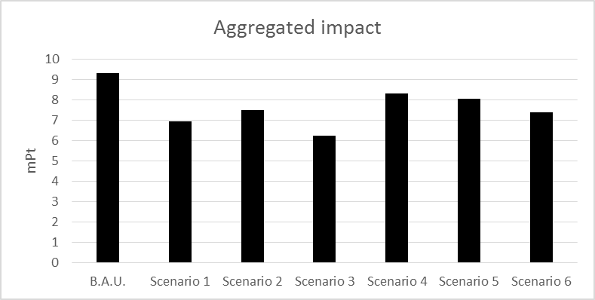
Aggregated Results

Slide 8
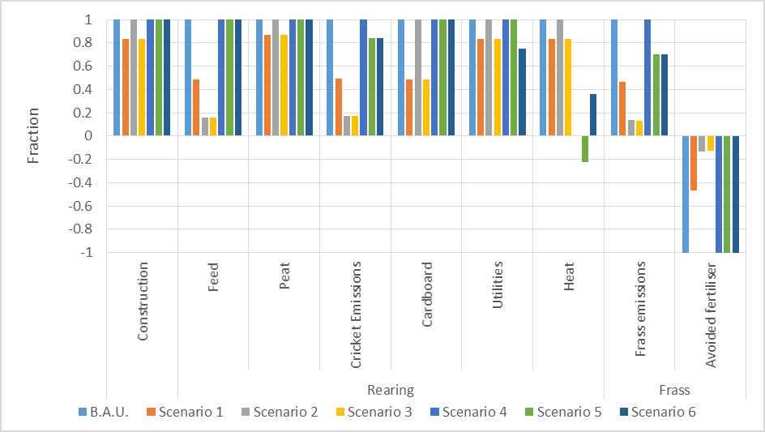
Significant Life Cycle Parts

Slide 9
Outputs
Planned:
  Paper on LCA of crickets for live food. Undergoing re-draft. Target: Int J LCA.
  Paper on unintended consequences. Target: Global Transitions.
  Possible paper on LCA of crickets for food. Target: Int J lCA.
  Paper and presentation at Sustainable Innovation, Epsom, 2019 on novel insect businesses.
Recent outputs:
  Presentation: Stepping Up Innovation from Model to Policy, Water Science for Impact, Wageningen, 10/18.
  Presentation: The Environmental Impact of Edible Insects, Doctoral College Conference, Surrey, 07/18.
  Presentation: The problem of food waste and how we can make the most of it, Fest. Of Res., Surrey, 06/18.
  Poster: The environmental impact of rearing insects for food within the UK, Gordon Conf., Switzerland, 05/18.

